Slide 1
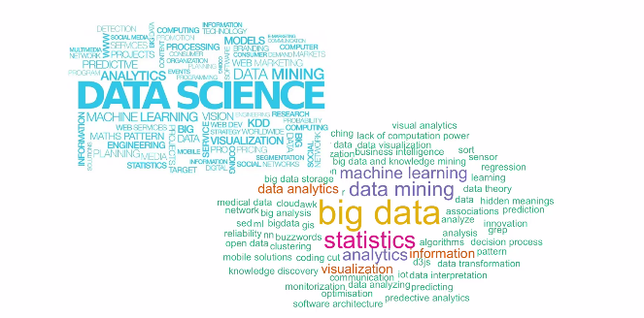
Data Science – Day 1

Slide 2
Outline
Understand the fundamental principles of Data science
Gain understanding of the core DS/Analytics concepts
Hands on sessions on select analytical tools (R) to gain better proficiency on various analytical algorithms and data mining techniques
How data can drive decisions
Practical examples / assignments
Bayes
GitHub info: https://github.com/ammumadhu/PPIDS
Rstudio
Kaggle
Gauss
Lasso
SVM
XGBoost
Markov

Slide 3

What is Data Science anyway ?

Slide 4
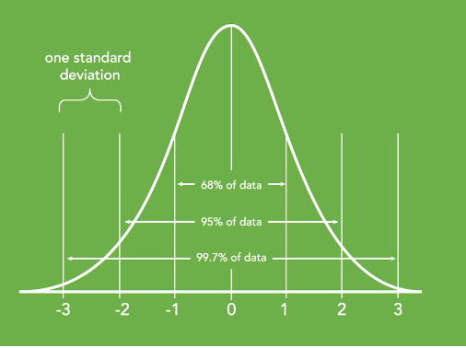
What does it really rely on and how is it different from rule based logic
2,4,6,8,10,….?
A,C,E,G,….?
2,4,6,8,9,10,15,18,21,28, ?
A,B,E,W,T,Y,Q,W,S,A,Q,R,,..?
Central Limit Theorem ➔

Slide 5
What is Data Science
Data
Decision Making
Event 1 : Plethora of data
Quantitative analysis
Event 2 : Advances in enormous computing power & faster algorithms Data Visualization
Business triggers the analysis of data through mathematical parlance supported by technology
Event 3 : Large data storage capability , Cloud computing , Parallel computing

Slide 6
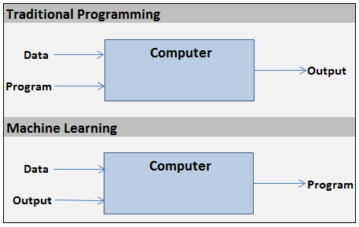
Variants of Data Science
Paradigms | Mathematics | Process | Outcome | Features | Interpretability
Statistics | a | a
Machine Learning |  |  | a | a | a
Deep Learning | a |  | a | a

Slide 7
Data Science Eco system
Business
Use case Formulation
Interpret Analytics Output
Domain Expertise
Data
Data Wrangling
Data Visualization
Noise removal
Maths
Statistical ML
Right Techniques
Algos
Technology
IT Eco system
Data Engineering /Pipeline
SDLC

Slide 8
What should be there in my arsenal to effectively practice Data science

Slide 9
Mathematics / Statistics Orientation ( Day 2)
At least one programming language (R / Python)
1 GUI Based / Cloud ML platform (H2O , Amazon Sagemaker, Rattle )
Github
Kaggle
Database / SQL

Slide 10
References :
Linear algebra Done right
Our 11th & 12th standard Mathematical books
ESL by Trevor Hastie
Datasciencecentral.com , r-bloggers , AnalyticsVidhya , dataelixir
For twitterati :
https://twitter.com/KirkDBorne
https://twitter.com/kdnuggets
https://twitter.com/MikeTamir
https://twitter.com/AnalyticsVidhya
https://twitter.com/dataiku

Slide 11
Data Science Taxonomy ?

Slide 12
Data Science
Supervised
Parametric
Non Parametric
Unsupervised
Clustering
Reinforcement
f(x)
KNN

Slide 13
Data Science Workflow ?

Slide 14
Take a first look into the data ; Determine obvious issues and relevant data points
List of data points and issues to fix
Make the data usable
Preliminary Report
Load the data into an adequate tool / framework
EDA
Data Visualization and Story Telling
Select the features
Train the model
Evaluate the model
Performance Measurement & optimization

Slide 15
Practical uses of Data science

Slide 16
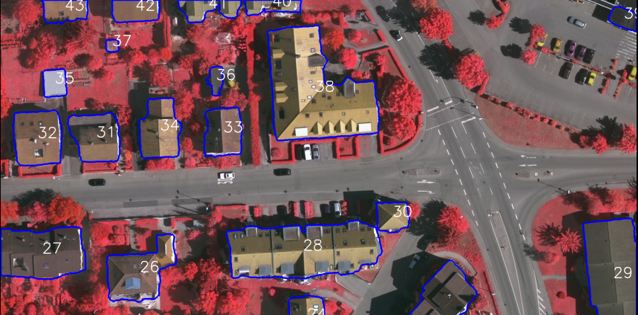
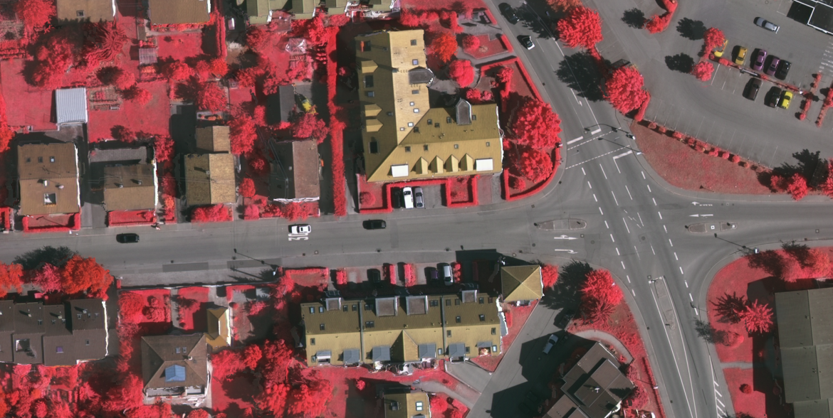

Slide 17
http://www.denseinl2.com/webcnn/digitdemo.html
http://algorithms-tour.stitchfix.com
Pixels to code

Slide 18
R

Slide 19
The market research team at AdRight is assigned the task to identify the profile of the typical customer for each treadmill product offered by CardioGood Fitness. The market research team decides to investigate whether there are differences across the product lines with respect to customer characteristics. The team decides to collect data on individuals who purchased a treadmill at a CardioGood Fitness retail store during the prior three months. The data are stored in the CardioGoodFitness.xls file. The team identifies the following customer variables to study: product purchased, TM195, TM498, or TM798; gender; age, in years; education, in years; relationship status, single or partnered; annual household income ($); average number of times the customer plans to use the treadmill each week; average number of miles the customer expects to walk/run each week; and self-rated fitness on an 1-to-5 ordinal scale, where 1 is poor shape and 5 is excellent shape. I. Compute descriptive statistics to create a customer profile for each CardioGood Fitness treadmill product line. II. Write a report to be presented to the management of CardioGood Fitness, detailing your findings.

Slide 20
Appendix

Slide 21
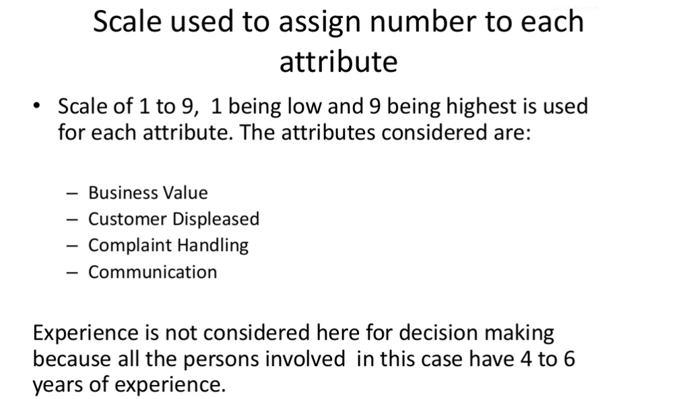

Slide 22
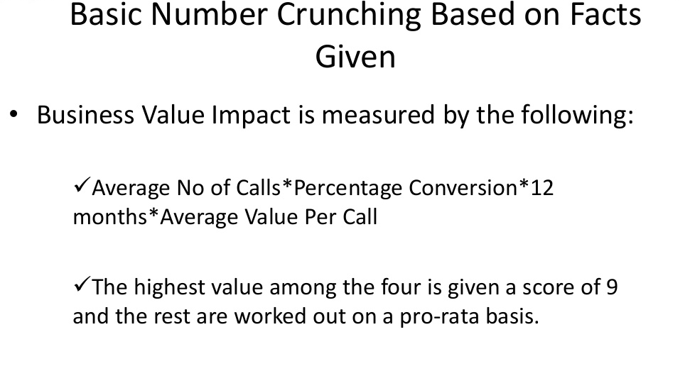

Slide 23
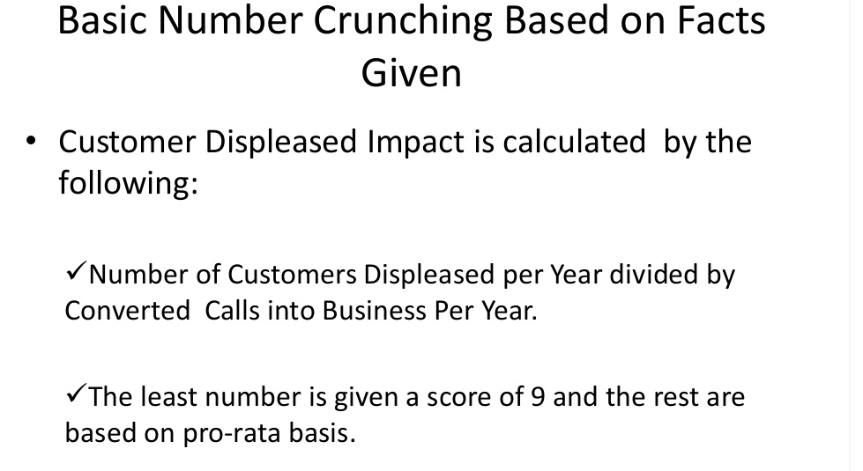

Slide 24
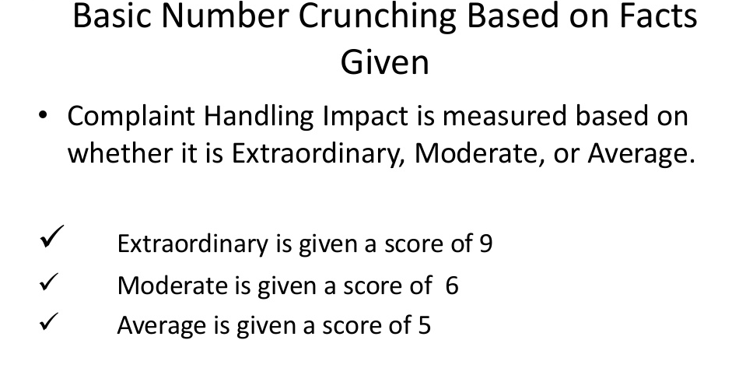

Slide 25
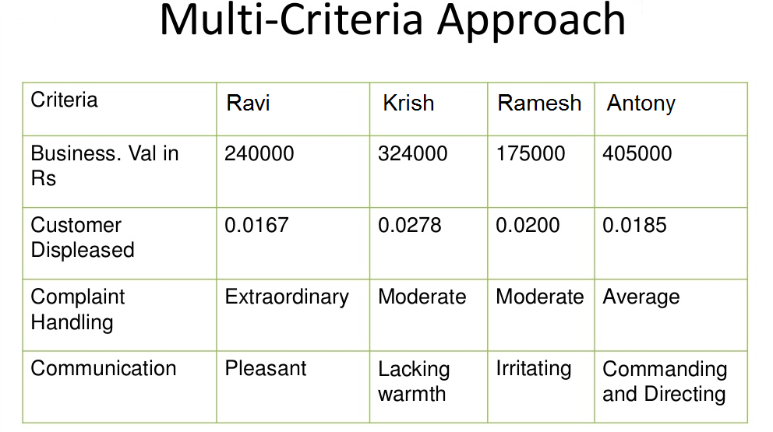

Slide 26
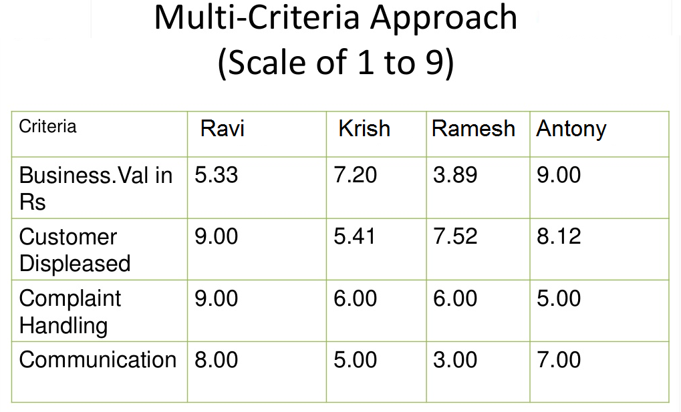

Slide 27
